Slide 1
Guided Segmentation of Images for 3D Reconstruction

Slide 2
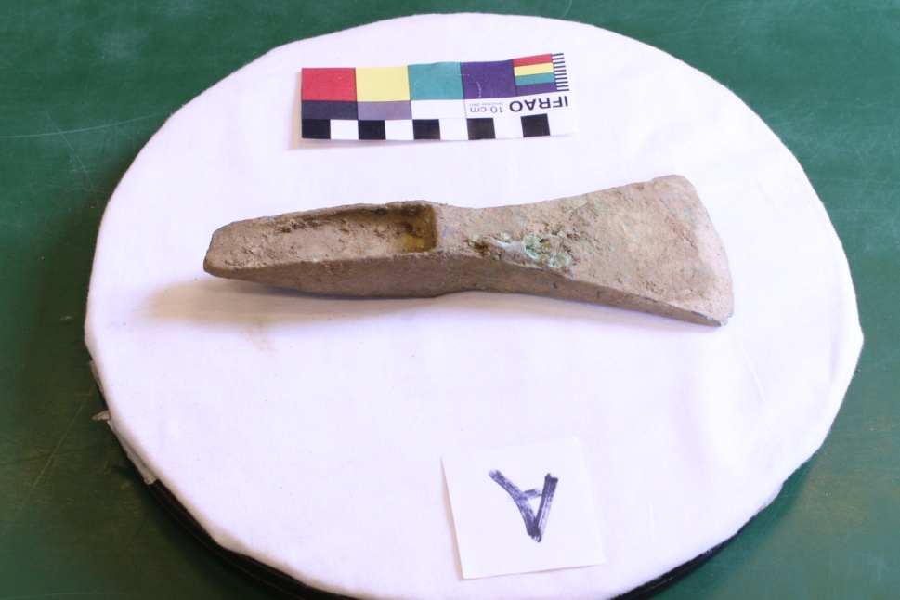
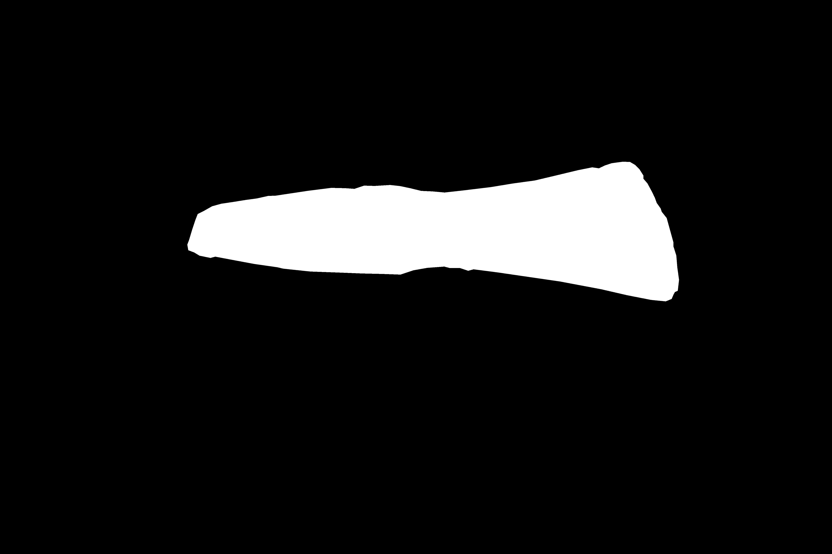
Masking
Original
Mask

Slide 3
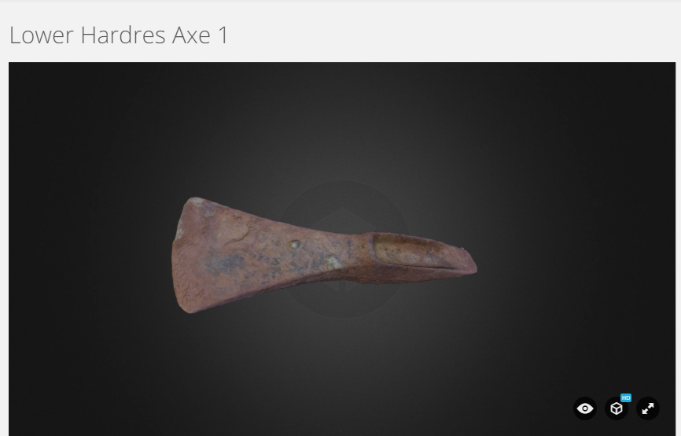
3D Reconstruction
https://sketchfab.com/models/f2c43c54d71c4609ab063ccbdcf0c0b3

Slide 4
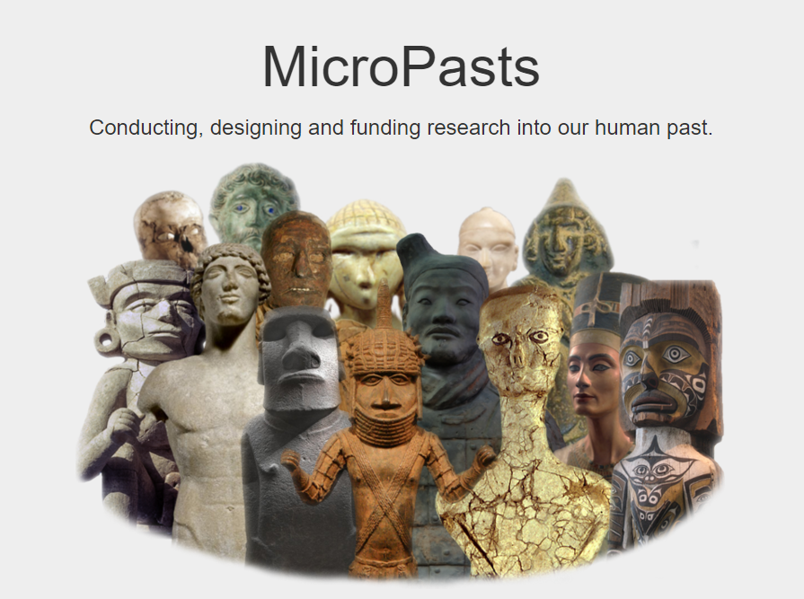

Slide 5
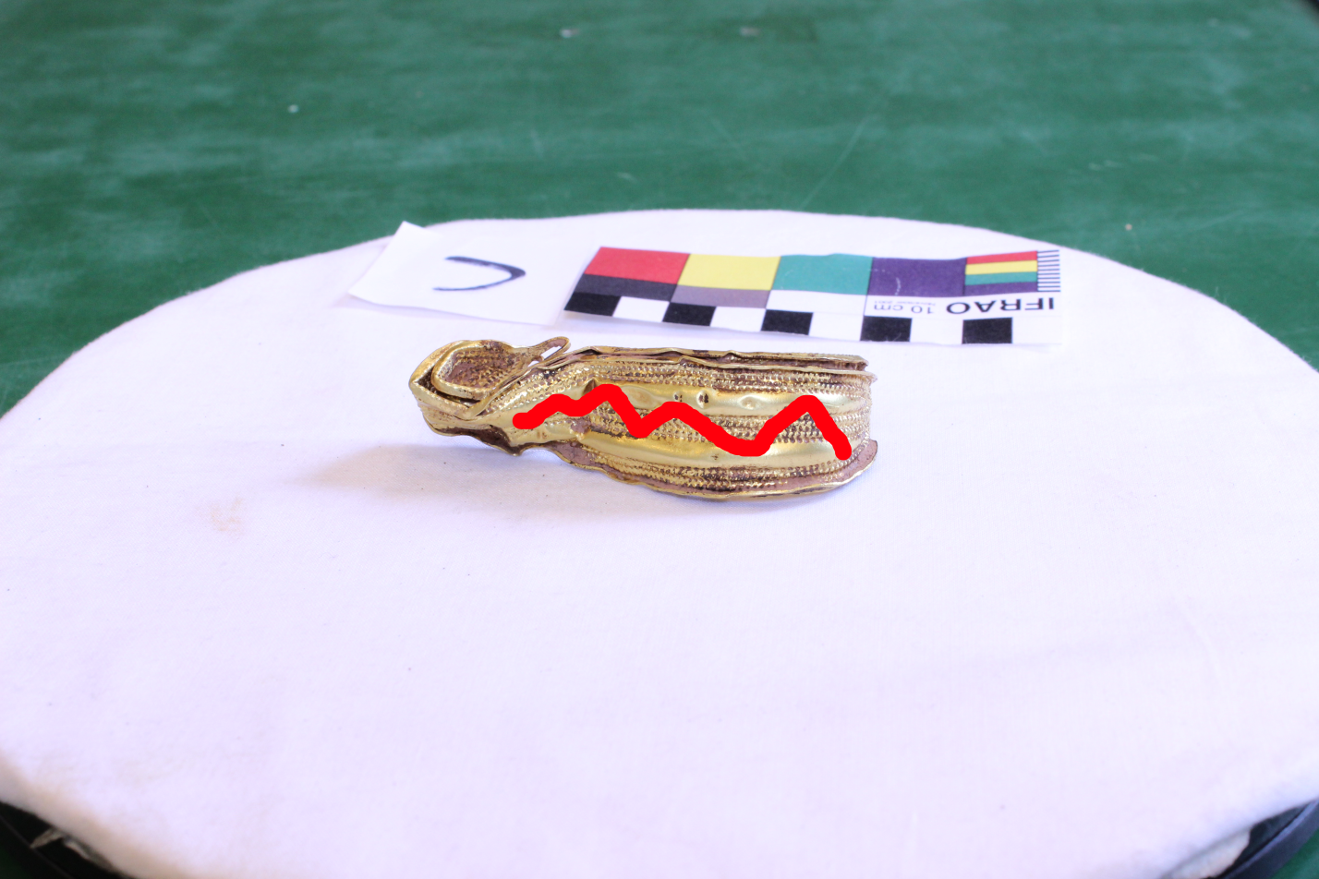
Minimise Human Input

Slide 6
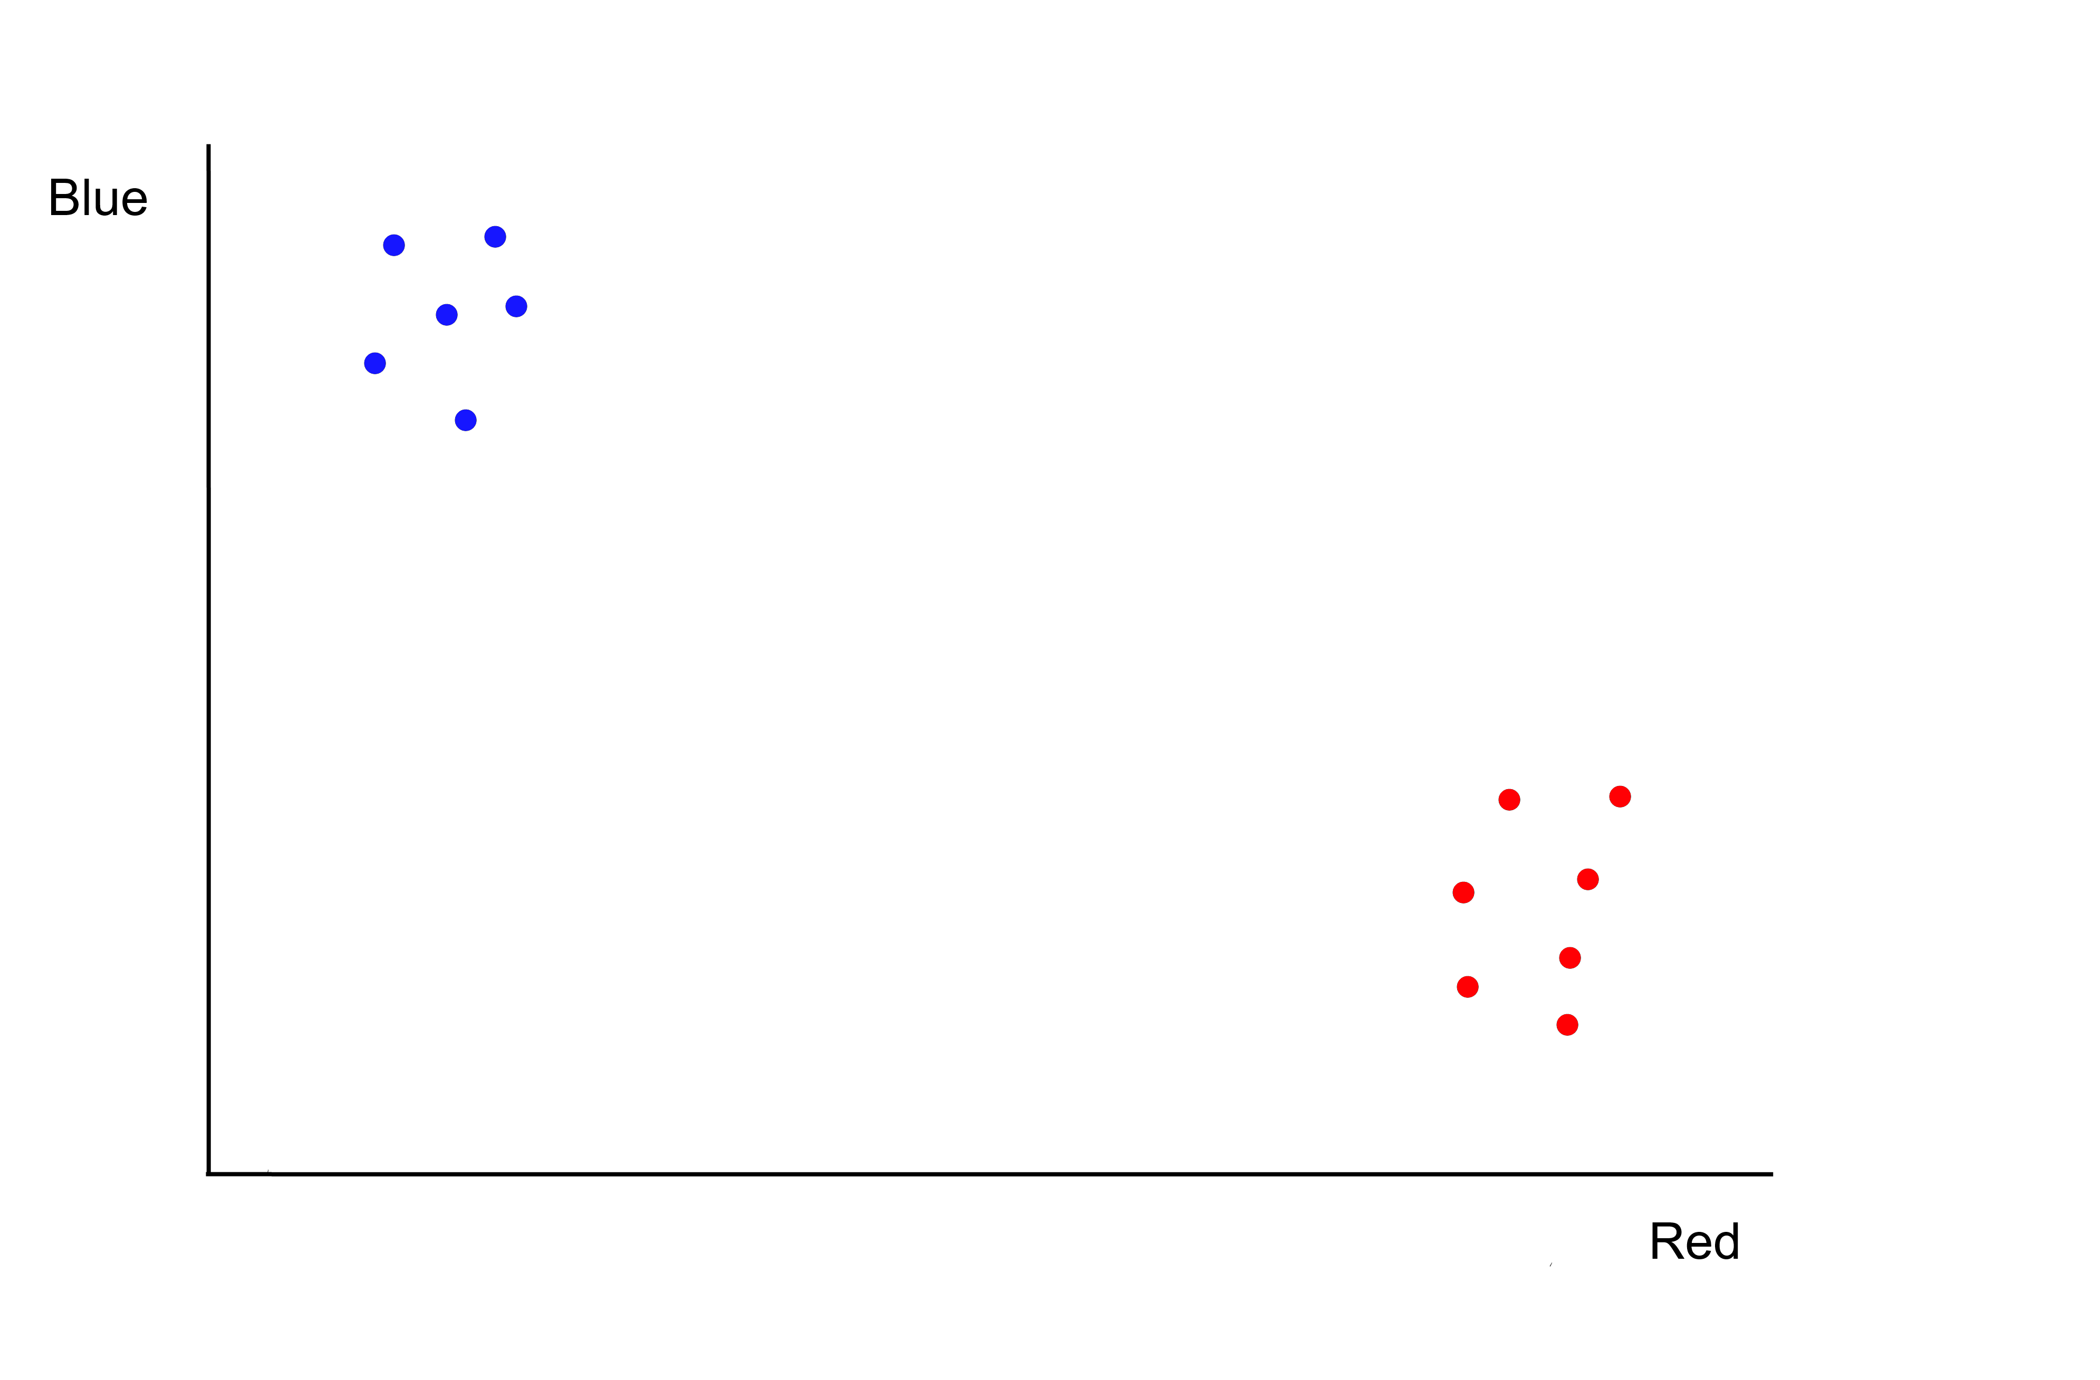
How?

Slide 7
Linear Classifier

Slide 8
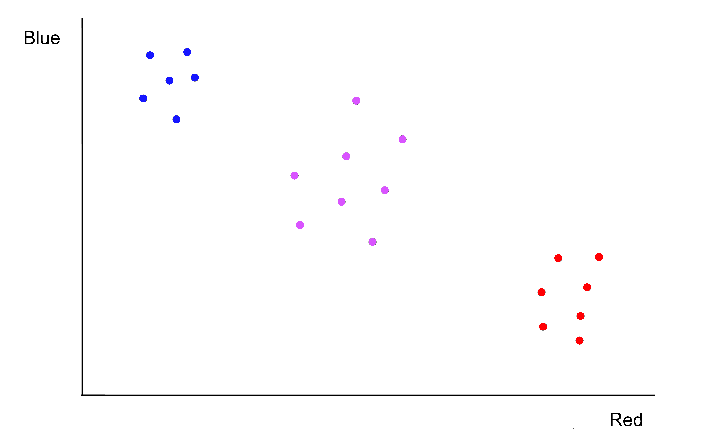
Decision Trees

Slide 9
Decision Trees

Slide 10
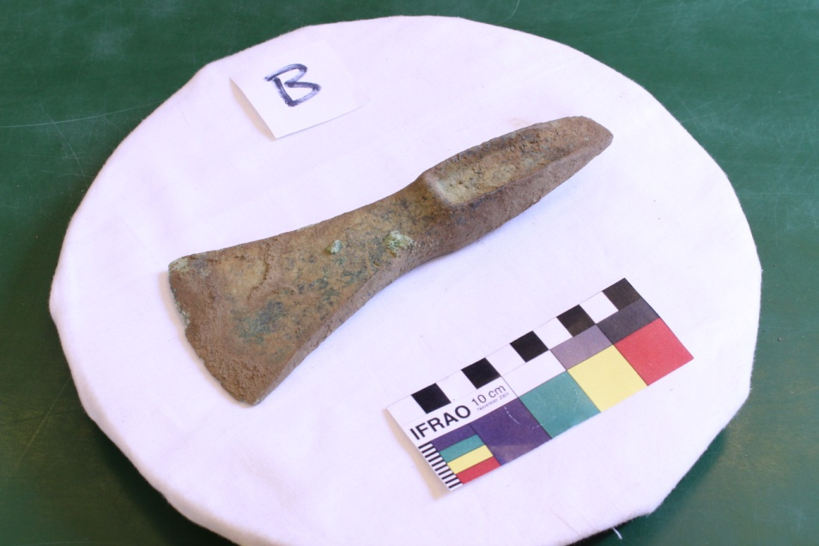
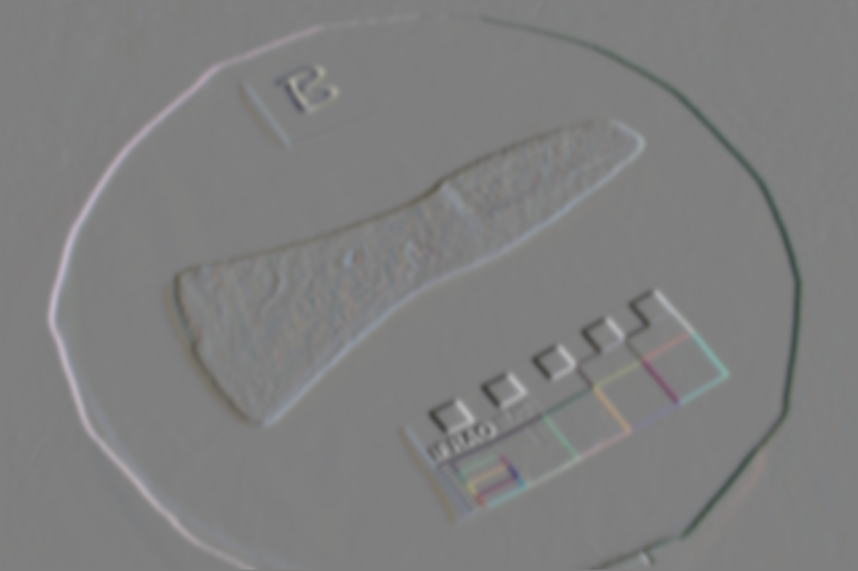
Sobel Filter
Original
Sobel Filtered

Slide 11

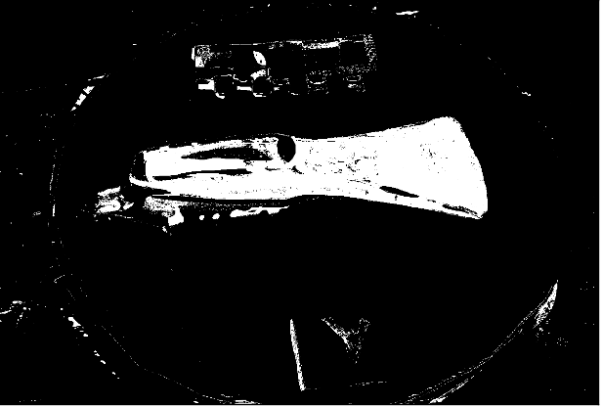
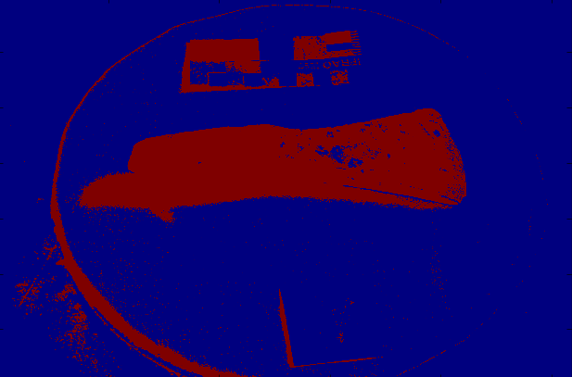
RGB vs Sobel
Original
Sobel Mask
RGB Mask

Slide 12
RGB vs Sobel
Original
Sobel Mask
RGB Mask

Slide 13
Performance on Axehead
Linear RGB error: 10.5%
Decision Trees RBG error: 7.9%
Decision Trees, Sobel, 1 layer error: 7.6%
Decision Trees, Sobel, 5 layers error: 1.4%

Slide 14
Thanks for listening

Slide 15
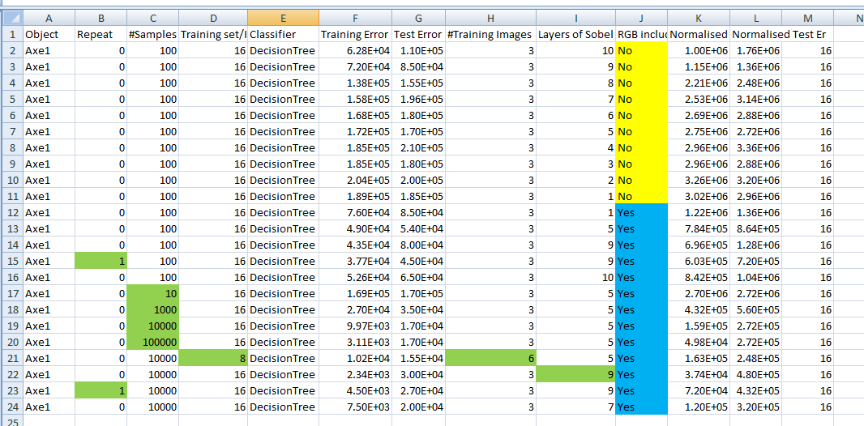
DT Sobel Results Axe1

Slide 16
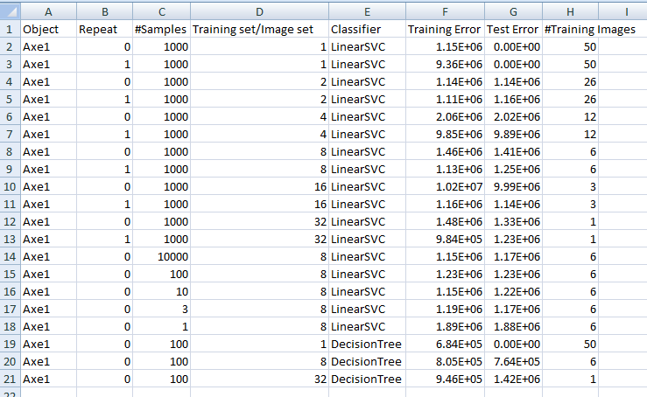
RGB Results Axe1

Slide 17
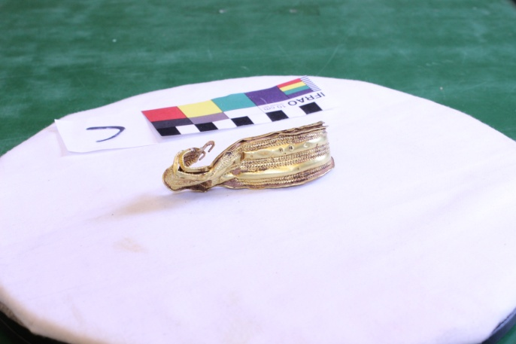

Identical Pixel Colours

Slide 18
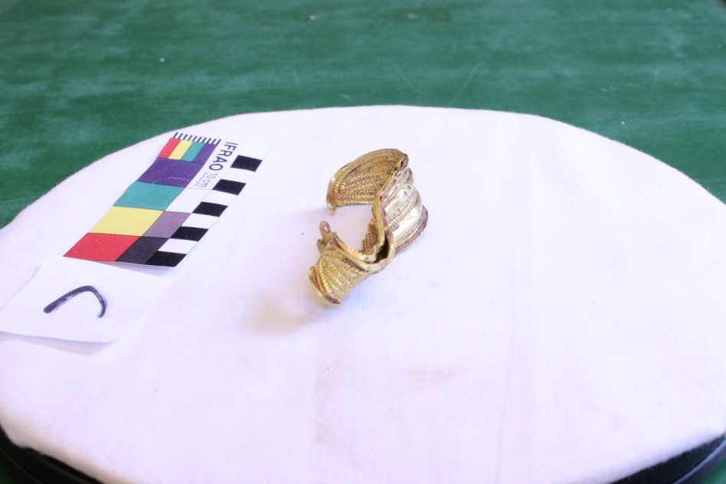
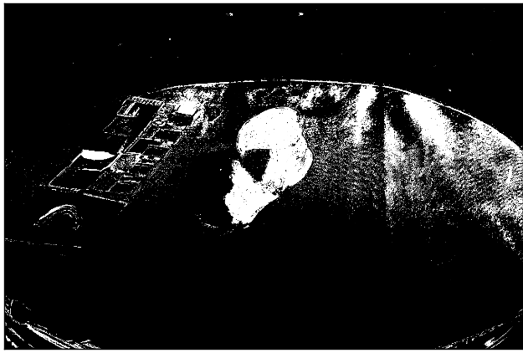
Sobel Mask Bracelet

Slide 19
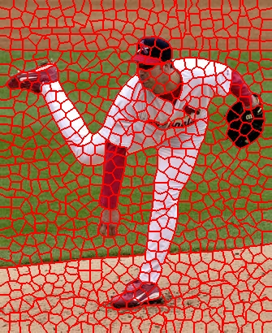
Super Pixels

